Slide 1
PostMan
API Testing

Slide 2
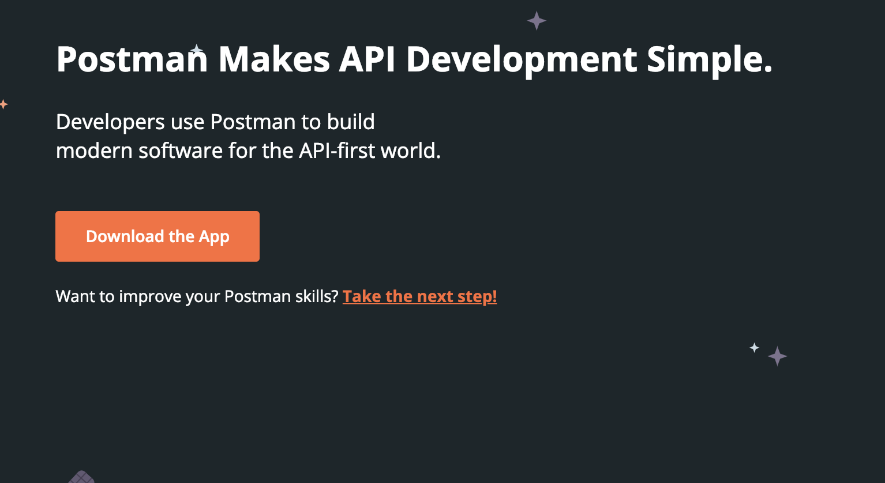
Get Postman
https://www.getpostman.com/

Slide 3
Testing Types (snap-shot)
Functionality testing — the API technically works.
Usability testing — the API is easy to work with.
Reliability testing — the API can be consistently connected to and lead to consistent results.
Load testing — the API can handle a large amount of calls.
Creativity testing — the API can handle being used in different ways.
Security testing — the API has defined security requirements including authentication, permissions and access controls.
API documentation testing — also called discovery testing, the API documentation easily guides the user.

Slide 4
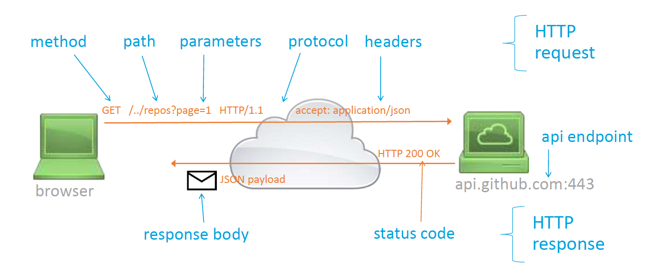
REST Calls
https://api.github.com/users/shawnmccarthy/repos?page=1&per_page=2

Slide 5


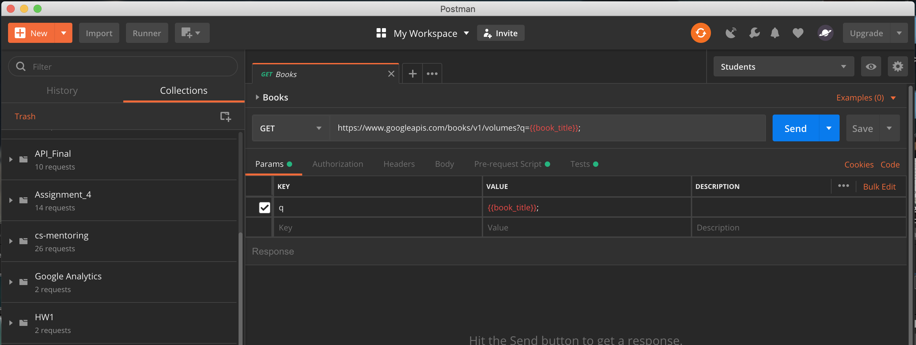



PostMan

Slide 6
Manage Environments

Slide 7
Case 1
Story: We want to get list of country in the system
What to test?
1. Response status 200
2. Response time (optional)
3. Response is equal to string (optional)
4. Total > 0
5. Content type json
6. Contain 'Indonesia'
What the test look like?

Slide 8
Test(s)
Notice the PASS

Slide 9
Prepare Variables

Slide 10
Use in Body

Slide 11
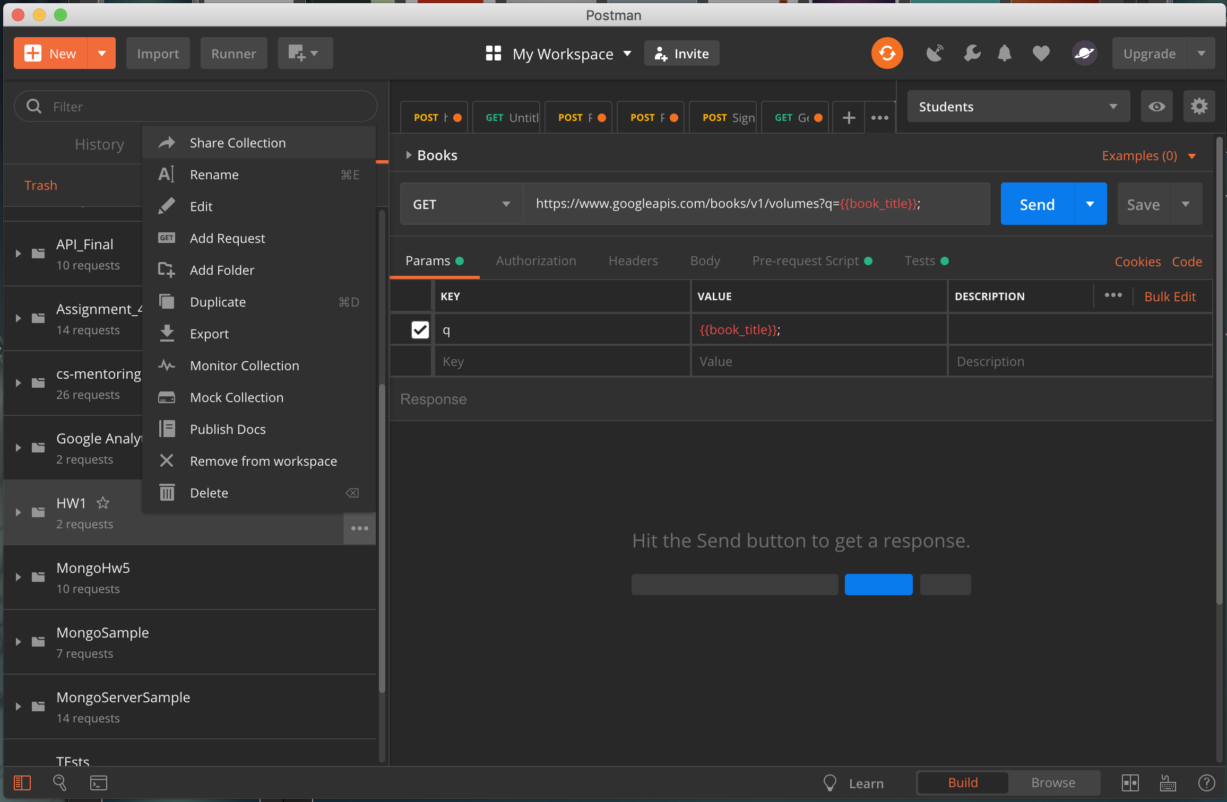
Create Export

Slide 12
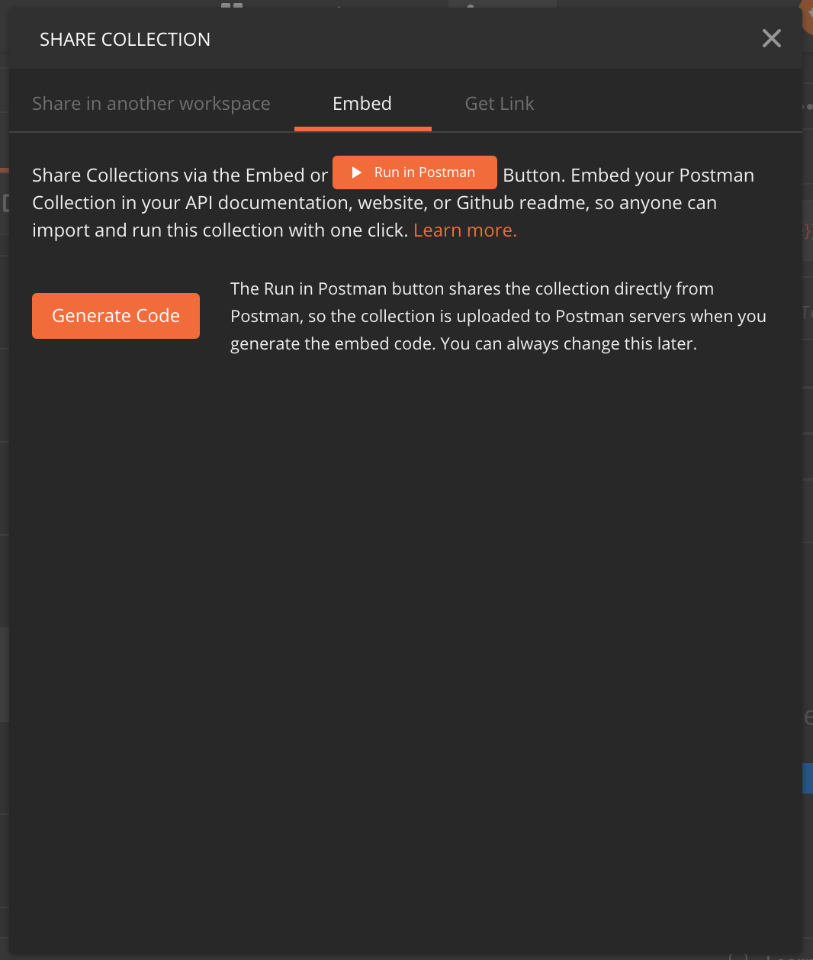
Generate Embed for Readme.md

Slide 13
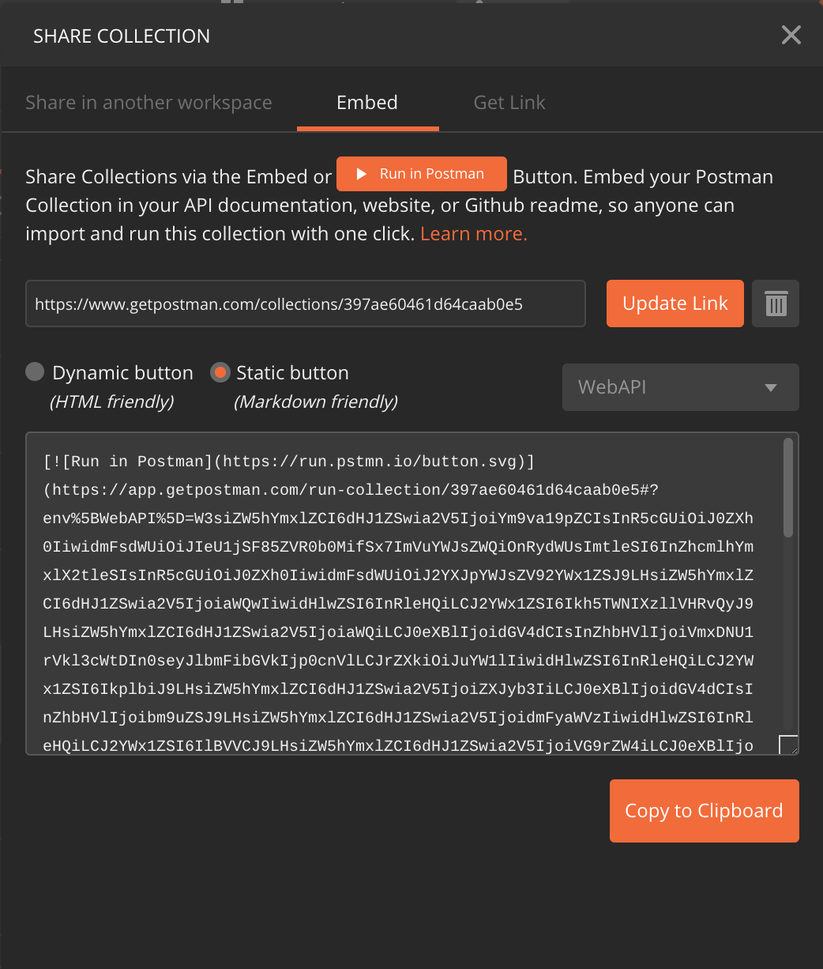
Create Readme.md

Slide 14
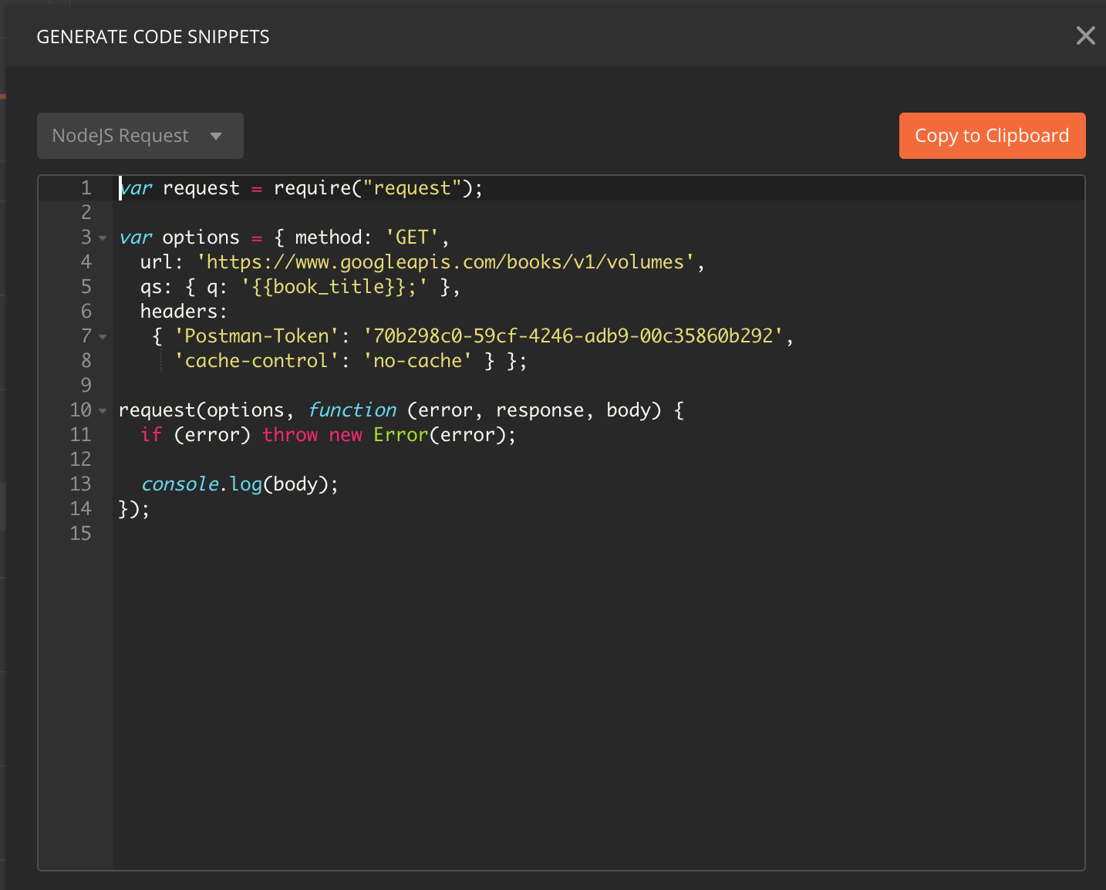
Generate Code with PostMan
1. Start from a REST call
2. Select your favorite language
3. Protect your token or leverage OAuth
4. Run your code

Slide 15
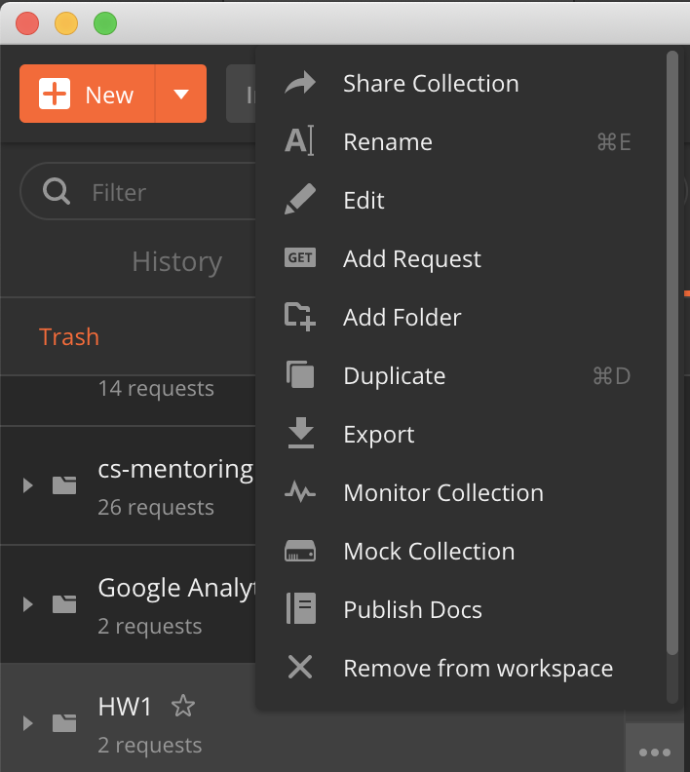
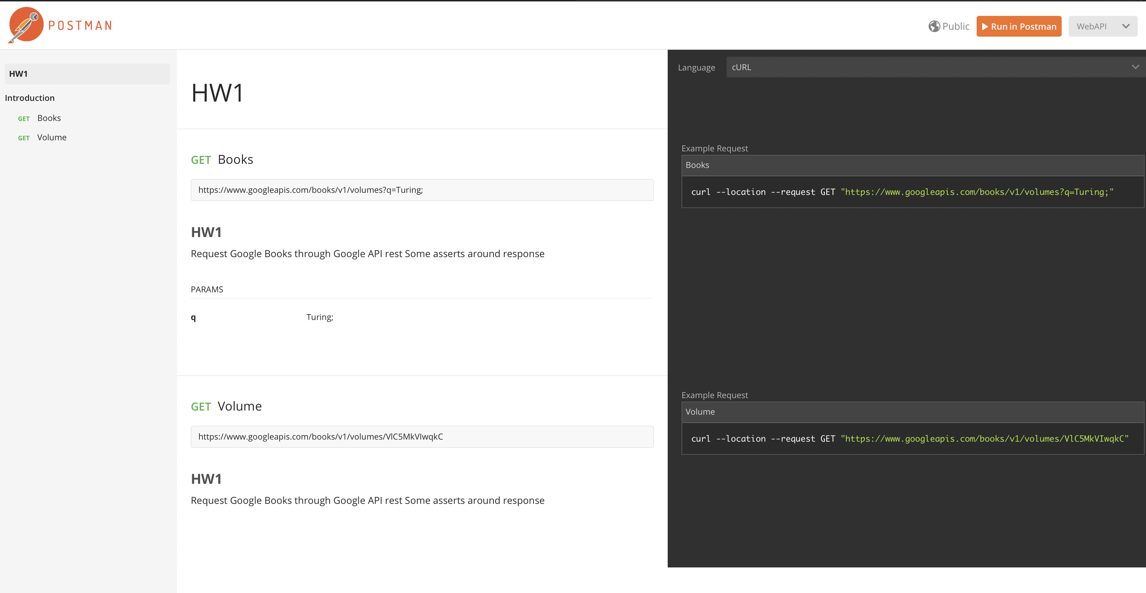
Publish Docs

Slide 16
NewMan

